Slide 1

Data Structures Using C++ 2E
Chapter 5
Linked Lists

Slide 2
Objectives
Learn about linked lists
Become aware of the basic properties of linked lists
Explore the insertion and deletion operations on linked lists
Discover how to build and manipulate a linked list
Learn how to construct a doubly linked list
Discover how to use the STL container list
Learn about linked lists with header and trailer nodes
Become aware of circular linked lists
Data Structures Using C++ 2E

Slide 3

Linked Lists
Collection of components (nodes)
  Every node (except last)
    Contains address of the next node
Node components
  Data: stores relevant information
  Link: stores address (pointer to the next node)
FIGURE 5-1 Structure of a node
Data Structures Using C++ 2E

Slide 4


Linked Lists (cont’d.)
Head (first)
  Address of the first node in the list
Arrow points to node address
  Stored in node
Down arrow in last node indicates NULL link field
FIGURE 5-2 Linked list
FIGURE 5-3 Linked list and values of the links
Data Structures Using C++ 2E

Slide 5
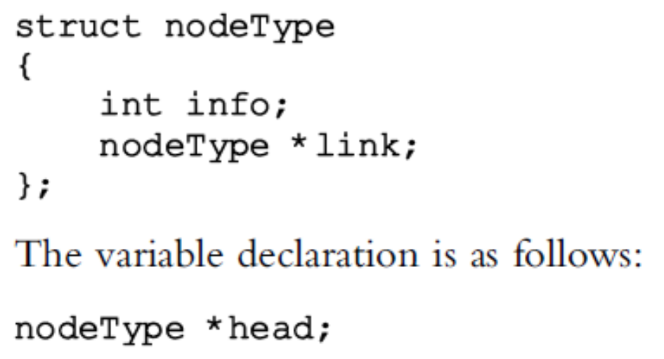
Linked Lists (cont’d.)
  Node: Declared as a class or struct
Structure of a node: two components
    info component: information
      Data type depends on specific application
    link component: pointer
      Data type of pointer variable: node type itself
Data Structures Using C++ 2E

Slide 6
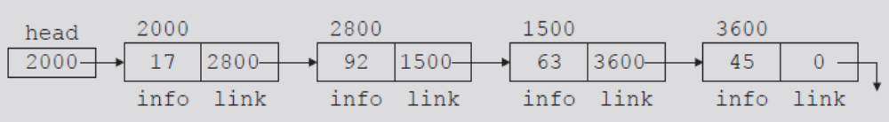
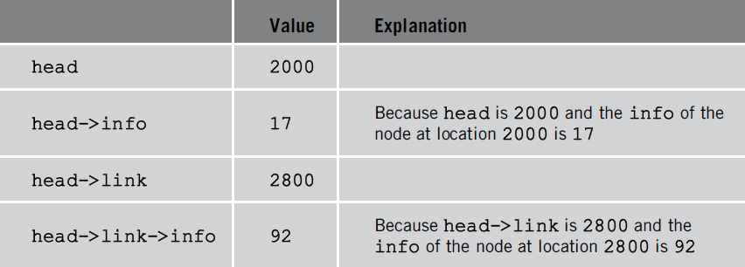
Linked Lists: Some Properties
Pointer head: stores address of first node
  Pointer to the node type
  NULL: empty linked list
FIGURE 5-4 Linked list with four nodes
TABLE 5-1 Values of head and some of
the nodes of the linked list in Figure 5-4
Data Structures Using C++ 2E

Slide 7
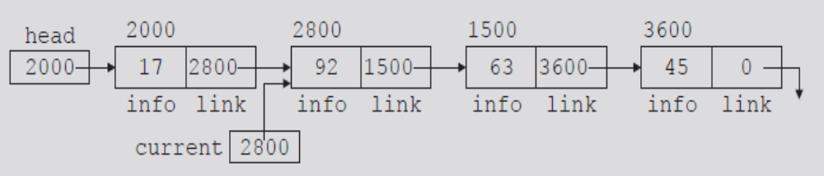
Linked Lists: Some Properties (cont’d.)
Pointer current: same type as pointer head
  current = head;
    Copies value of head into current
  current = current->link;
    Copies value of current->link (2800) into current
FIGURE 5-5 List after the statement current = current->link; executes
Data Structures Using C++ 2E

Slide 8
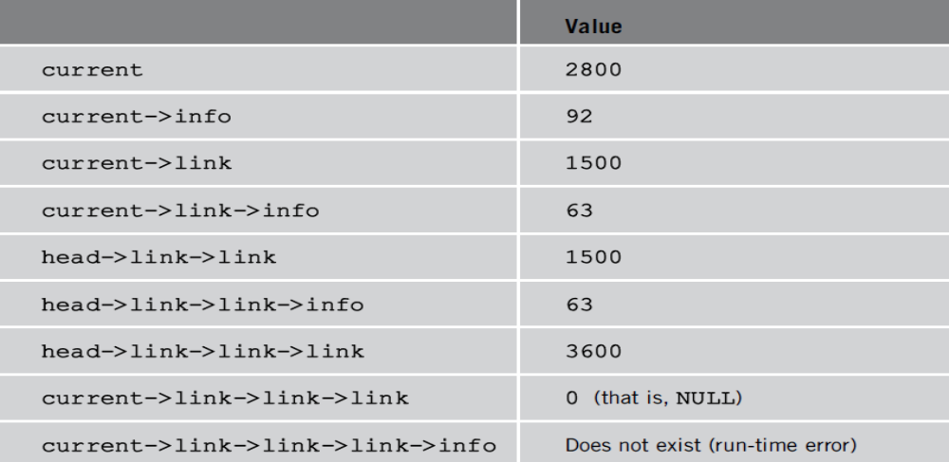
Linked Lists: Some Properties (cont’d.)
FIGURE 5-5 List after the statement current = current->link; executes
TABLE 5-2 Values of current, head, and some of the nodes of the linked list in Figure 5-5
Data Structures Using C++ 2E

Slide 9
Traversing a Linked List
Basic linked list operations
  Search list to determine if particular item is in the list
  Insert item in list
  Delete item from list
These operations require list traversal
  Given pointer to list first node, we must step through list nodes
Data Structures Using C++ 2E

Slide 10
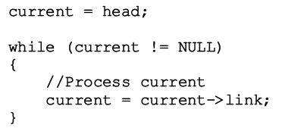
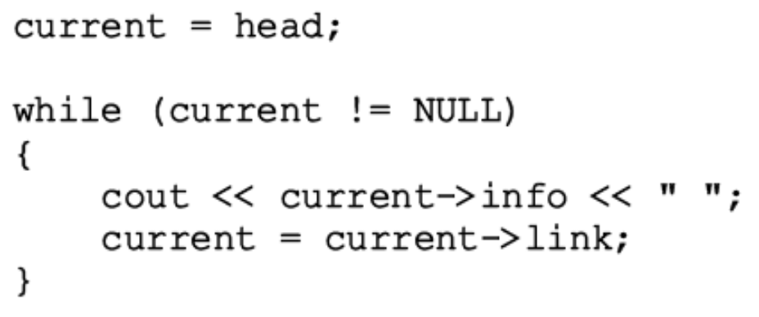
Traversing a Linked List (cont’d.)
Suppose head points to a linked list of numbers
  Code outputting data stored in each node
Data Structures Using C++ 2E

Slide 11
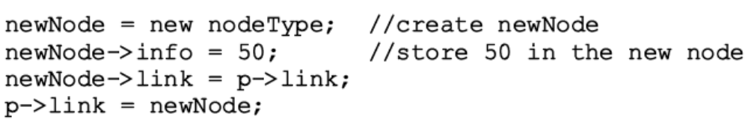
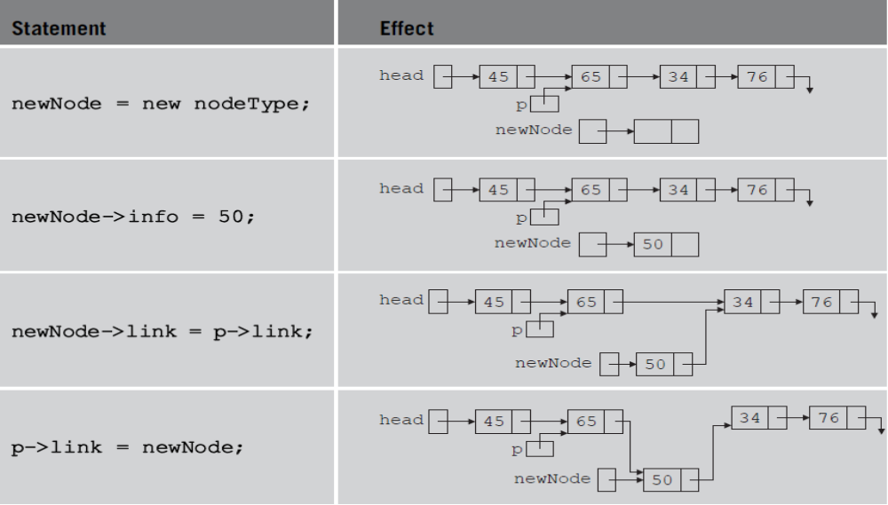
Item Insertion and Deletion
Insertion: one pointer (page 270)
TABLE 5-3 Inserting a node in a linked list
Data Structures Using C++ 2E

Slide 12

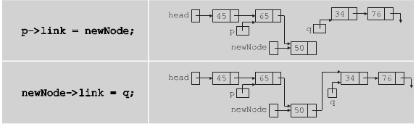
Item Insertion and Deletion (cont’d.)
Insertion: two pointers
Data Structures Using C++ 2E

Slide 13
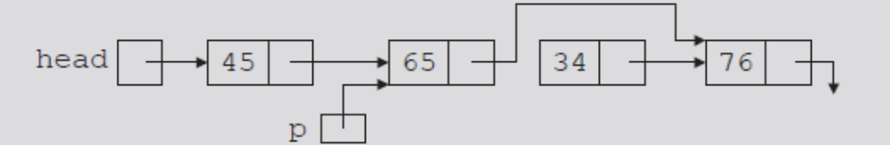
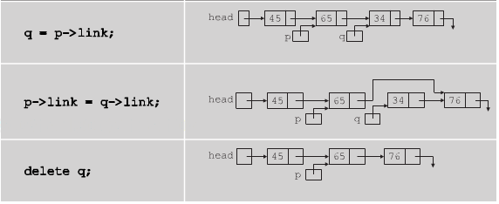
Item Insertion and Deletion (cont’d.)
Deletion: Memory still occupied by node after deletion
  Memory is inaccessible
  Deallocate memory using a pointer to this node
Memory leak
FIGURE 5-10 List after the statement
p->link = p->link->link; executes
Data Structures Using C++ 2E

Slide 14






Building a Linked List
Build a linked list with data 2 15 8 24 34
Data Structures Using C++ 2E

Slide 15
Building a Linked List (cont’d)
Ways to build linked list
  Forward
    New node always inserted at end of the linked list
    See example on page 274
    See function buildListForward on page 277
  Backward
    New node always inserted at the beginning of the list
    See example on page 277
    See function buildListBackward on page 278
Data Structures Using C++ 2E

Slide 16
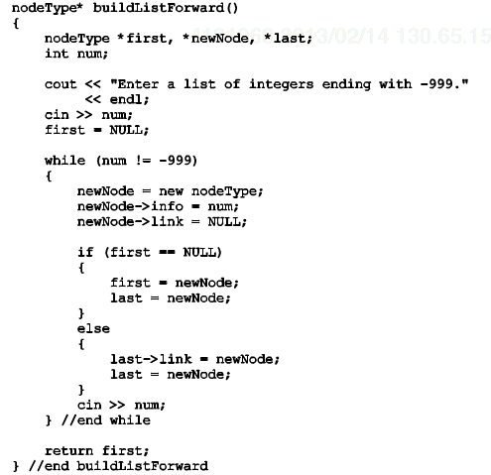
Data Structures Using C++ 2E

Slide 17
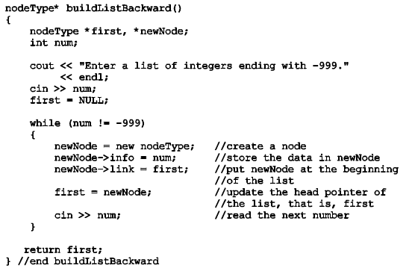
Data Structures Using C++ 2E

Slide 18
Linked List as an ADT
Basic operations
  Initialize the list
  Is list empty
  Print the list
  Find the length
  Destroy the list
  Retrieve the info from the 1st node
  Retrieve the info from the last node
  Search the list for a given item
  Insert an item
  Delete an item
  Make a copy
Data Structures Using C++ 2E

Slide 19
Linked List as an ADT (cont’d)
Two types of linked lists: sorted, unsorted
  the implement search, insert, and remove are different
class linkedListType
  Implements basic linked list operations as an ADT
  Defined as an abstract class
  Derive two classes using inheritance
    unorderedLinkedList and orderedLinkedList
Unordered linked list functions
  buildListForward and buildListBackward
  Two more functions accommodate both operations
    insertFirst and insertLast
Data Structures Using C++ 2E
Notes:
Using insertFirst and insertLast, you can implement both buildListForward and buildListBakcward
Why do we define some functions as virtual functions? What do they mean?

Slide 20
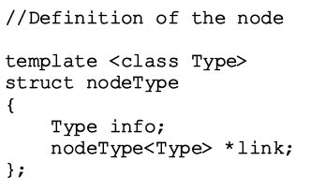
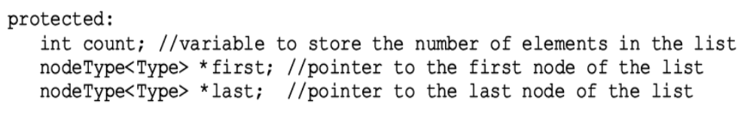
Linked List as an ADT (cont’d)
Definition of the struct nodeType
Member variables of class linkedListType
  Three instance variables
Data Structures Using C++ 2E

Slide 21
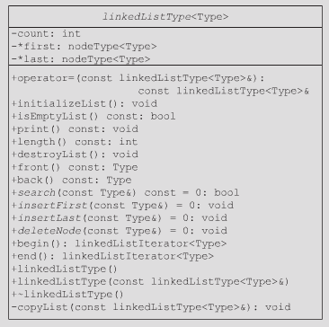
Abstract class
#
#
#
Pure virtual function
Data Structures Using C++ 2E

Slide 22
Linked List Iterators
To process each node
  Must traverse list starting at first node
Iterator
  Object producing each element of a container
  One element at a time
  Operations on iterators: ++ and *
  See code on pages 280-281
  Functions of class linkedListIterator
Data Structures Using C++ 2E

Slide 23
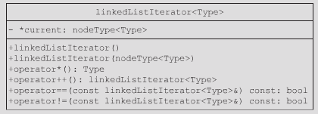
Linked List Iterators (cont’d.)
O(1) for each function
Data Structures Using C++ 2E

Slide 24
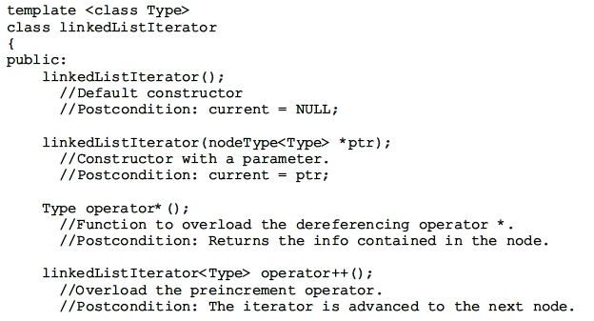
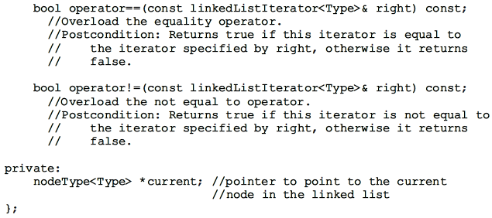
Data Structures Using C++ 2E

Slide 25
Abstract class
#
#
#
Pure virtual function
Data Structures Using C++ 2E

Slide 26
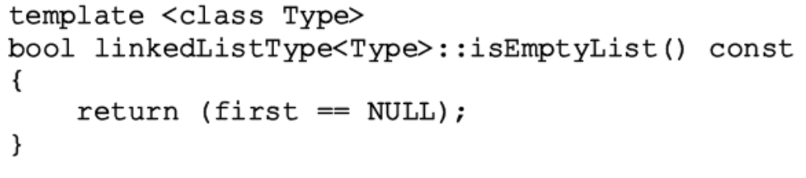
Linked List as an ADT
Abstract class linkedListType
  Defines basic properties of a linked list as an ADT
  See code on page 282
  Empty list: first is NULL
    Definition of function isEmptyList
Data Structures Using C++ 2E

Slide 27
Linked List as an ADT (cont’d.)
Default constructor
  Initializes list to an empty state
Destroy the list
  Deallocates memory occupied by each node
Initialize the list
  Reinitializes list to an empty state
    Must delete the nodes (if any) from the list
  Default constructor, copy constructor
    Initialized list when list object declared
Print the list
  Must traverse the list starting at first node
Data Structures Using C++ 2E

Slide 28
Linked List as an ADT (cont’d.)
Length of a list
  Number of nodes stored in the variable count
  Function length
    Returns value of variable count
Retrieve the data of the first node
  Function front
    Returns the info contained in the first node
    If list is empty, assert statement terminates program
Retrieve the data of the last node
  Function back
    Returns info contained in the last node
    If list is empty, assert statement terminates program
Data Structures Using C++ 2E

Slide 29
Linked List as an ADT (cont’d.)
Begin and end
  Function begin returns an iterator to the first node in the linked list
  Function end returns an iterator to one element past the last node in the linked list
Copy the list
  Makes an identical copy of a linked list
    Create node called newNode
    Copy node info from original list into newNode
    Insert newNode at the end of list being created
  See function copyList on page 289
Data Structures Using C++ 2E

Slide 30
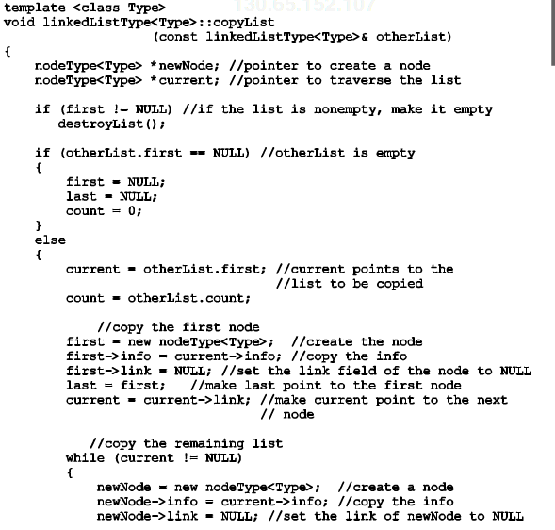
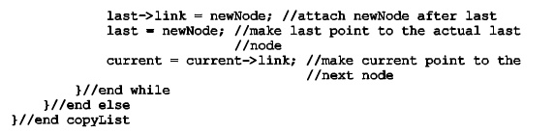
Data Structures Using C++ 2E

Slide 31
Linked List as an ADT (cont’d.)
Destructor
  When class object goes out of scope
    Deallocates memory occupied by list nodes
  Memory allocated dynamically
    Resetting pointers first and last
      Does not deallocate memory
    Must traverse list starting at first node
      Delete each node in the list
  Calling destroyList destroys list
  Time complexity?
Data Structures Using C++ 2E

Slide 32
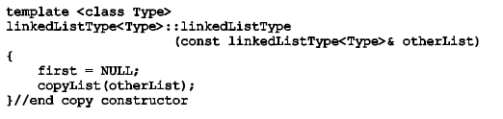
Linked List as an ADT (cont’d.)
Copy constructor
  Makes identical copy of the linked list
  Function copyListc checks whether original list empty
    Checks value of first
  Must initialize first to NULL
    Before calling the function copyList
Data Structures Using C++ 2E

Slide 33
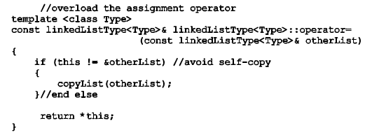
Linked List as an ADT (cont’d.)
Overloading the assignment operator
  Similar to copy constructor definition
Data Structures Using C++ 2E

Slide 34
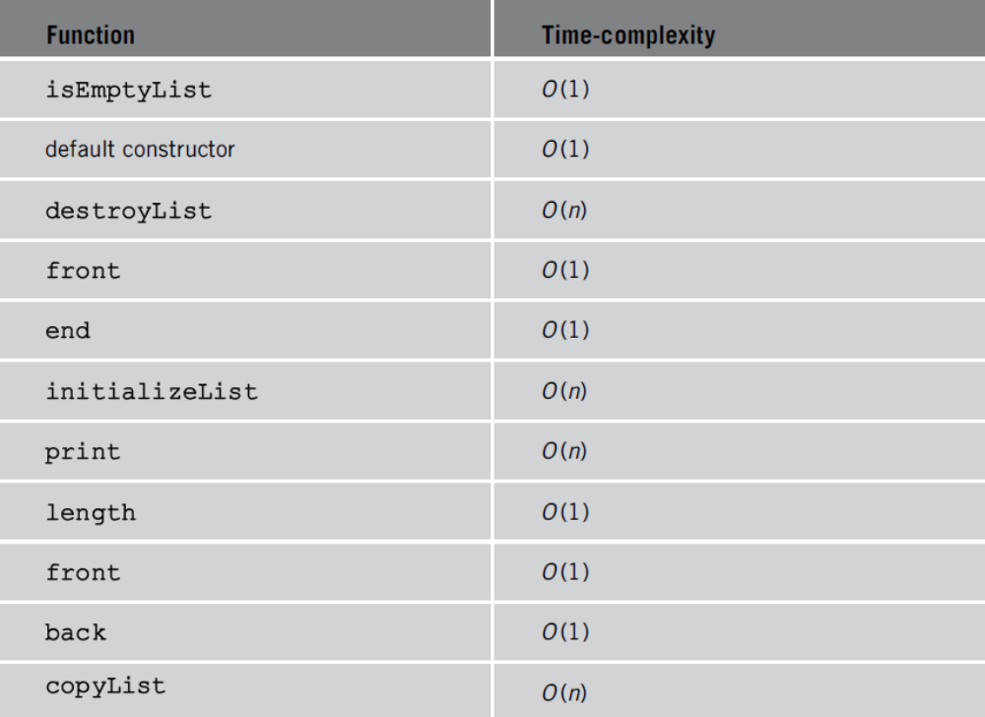

TABLE 5-6 Time-complexity of the operations of the
class linkedListType
Data Structures Using C++ 2E

Slide 35
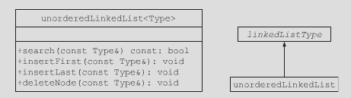
Unordered Linked Lists
Derive class unorderedLinkedList from the abstract class linkedListType
  Implement the operations search, insertFirst, insertLast, deleteNode
See code on page 292
  Defines an unordered linked list as an ADT
Data Structures Using C++ 2E

Slide 36
Unordered Linked Lists (cont’d.)
Search the list
  Steps
    Step one: Compare the search item with the current node in the list
      If the info of the current node is the same as the search item, stop the search
      otherwise, make the next node the current node
    Step two: Repeat Step one until either the item is found or no more data is left in the list to compare with the search item
  See function search on page 293
Data Structures Using C++ 2E

Slide 37
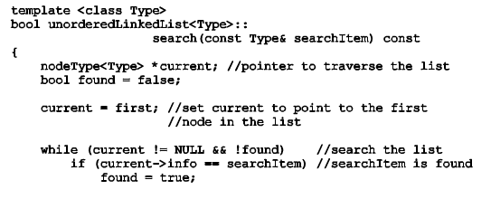

Data Structures Using C++ 2E

Slide 38
Unordered Linked Lists (cont’d.)
Insert the first node
  Steps
    Create a new node
    If unable to create the node, terminate the program
    Store the new item in the new node
    Insert the node before first
    Increment count by one
  See function insertFirst on page 294
Data Structures Using C++ 2E

Slide 39
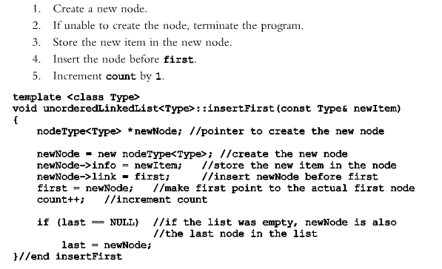
Data Structures Using C++ 2E

Slide 40
Unordered Linked Lists (cont’d.)
Insert the last node
  Similar to definition of member function insertFirst
  Insert new node after last
  See function insertLast on page 294
Data Structures Using C++ 2E

Slide 41

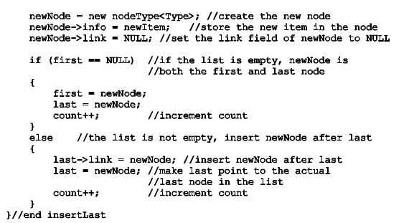
Data Structures Using C++ 2E

Slide 42
Unordered Linked Lists (cont’d.)
Delete a node
  Consider the following cases:
    The list is empty
    The node is nonempty and the node to be deleted is the first node
    The node is nonempty and the node to be deleted is not the first node, it is somewhere in the list
    The node to be deleted is not in the list
  See pseudocode on page 295
  See definition of function deleteNode on page 297
Data Structures Using C++ 2E

Slide 43
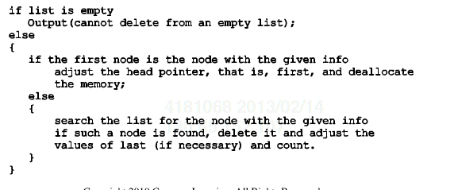
Pseudo Code
Data Structures Using C++ 2E

Slide 44
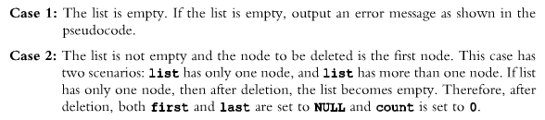

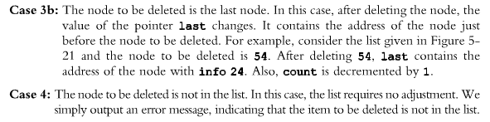
Data Structures Using C++ 2E
Notes:
Go over on board each case, especially explain in case 3, why do we need trailCurrent

Slide 45
Exercise
Please implement
Template <class Type>
unorderedLinkedList<Type>::deleteNode(const Type &deleteItem)
Data Structures Using C++ 2E

Slide 46
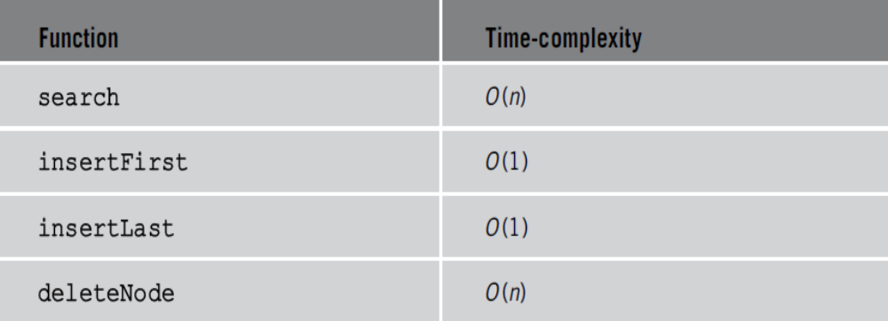
Unordered Linked Lists (cont’d.)
TABLE 5-7 Time-complexity of the operations of the
class unorderedLinkedList
Data Structures Using C++ 2E

Slide 47
Header File of the Unordered Linked List
Create header file defining class unorderedListType
  See class unorderedListType code on page 299
    Specifies members to implement basic properties of an unordered linked list
    Derived from class linkedListType
Data Structures Using C++ 2E

Slide 48
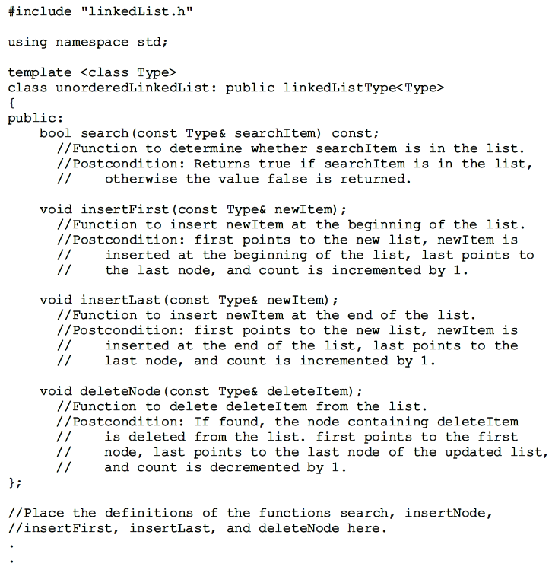

Data Structures Using C++ 2E

Slide 49
Ordered Linked Lists
Derive class orderedLinkedList from class linkedListType
  Provide definitions of the abstract functions:
    insertFirst, insertLast, search, deleteNode
  Ordered linked list elements are arranged using some ordering criteria
    Assume elements of an ordered linked list arranged in ascending order
See class orderedLinkedList on pages 300-301
Data Structures Using C++ 2E

Slide 50
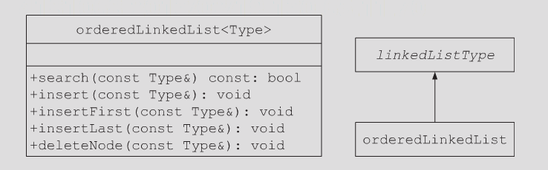
Ordered Linked Lists (cont’d)
Data Structures Using C++ 2E

Slide 51
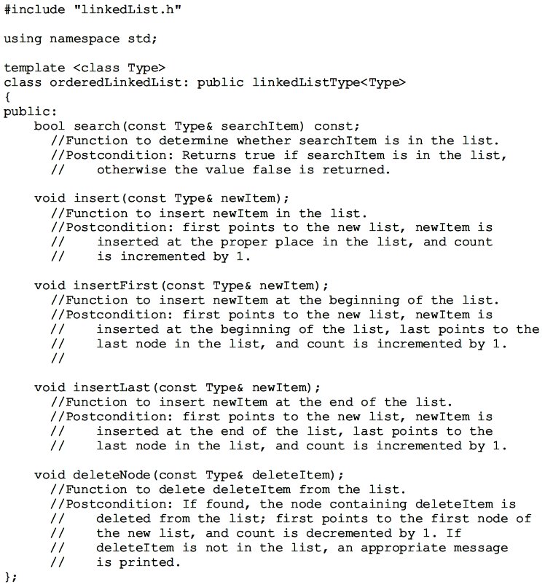
Data Structures Using C++ 2E

Slide 52
Ordered Linked Lists (cont’d.)
Search the list
  Steps describing algorithm
    Step one: Compare the search item with the current node in the list
      If the info of the current node is greater than or equal to the search item, stop the search
      otherwise, make the next node the current node
    Step two: Repeat Step one until either an item in the list that is greater than or equal to the search item is found, or no more data is left in the list to compare with the search item
      at the end of while loop, check if the found item is equal to the search item
Data Structures Using C++ 2E
Notes:
Note that at the end of while loop, it needs to check if the found item is equal to the search item

Slide 53
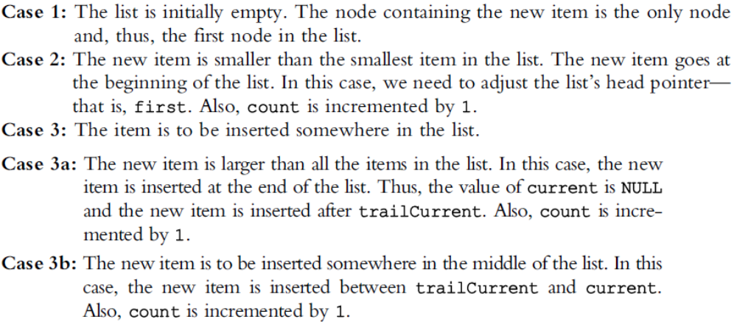
Ordered Linked Lists (cont’d.)
Insert a node
  Find place where new item goes
  Consider the following cases (code on p.304)
Data Structures Using C++ 2E

Slide 54
Ordered Linked Lists (cont’d.)
Insert first and insert last
  Function insertFirst
    Must be inserted at the proper place
  Function insertLast
    Inserts new item at the proper place
Data Structures Using C++ 2E

Slide 55
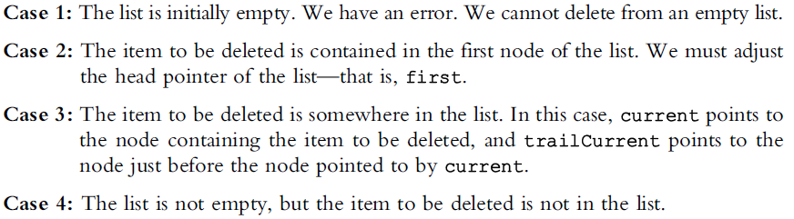
Ordered Linked Lists (cont’d.)
Delete a node
  Several cases to consider
  See function deleteNode code on page 306
Data Structures Using C++ 2E

Slide 56
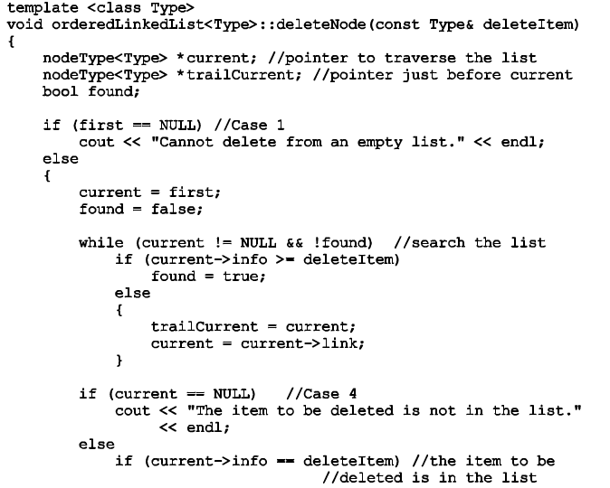
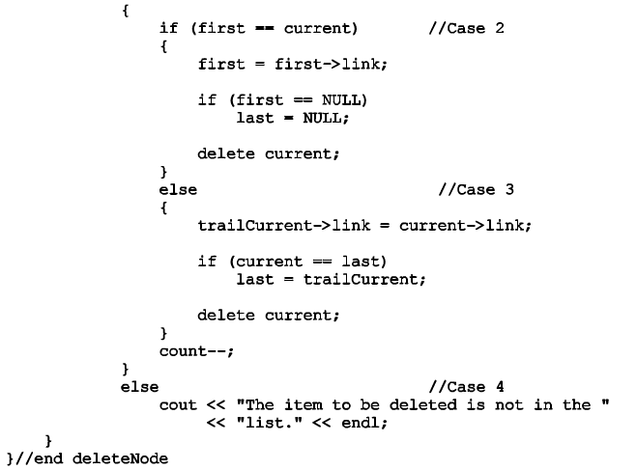
Data Structures Using C++ 2E

Slide 57
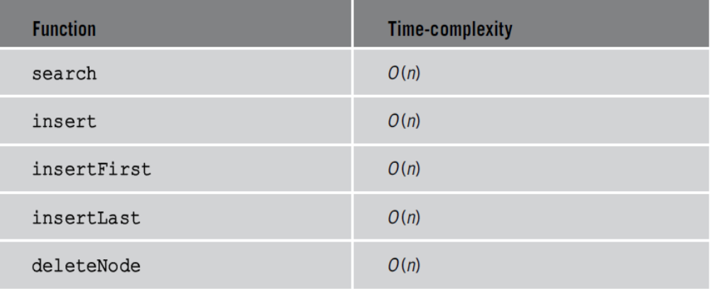
Ordered Linked Lists (cont’d.)
TABLE 5-8 Time-complexity of the operations of
the class orderedLinkedList
Data Structures Using C++ 2E

Slide 58
Header File of the Ordered Linked List
See code on page 308
  Specifies members to implement the basic properties of an ordered linked list
  Derived from class linkedListType
See test program on page 309
  Tests various operations on an ordered linked list
Data Structures Using C++ 2E

Slide 59
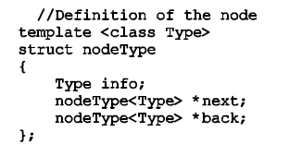
Doubly Linked Lists
Traversed in either direction
Typical operations
  Initialize the list
  Destroy the list
  Determine if list empty
  Search list for a given item
  Insert an item
  Delete an item, and so on
See code on page 311
  Class specifying members to implement properties of an ordered doubly linked list
Data Structures Using C++ 2E

Slide 60
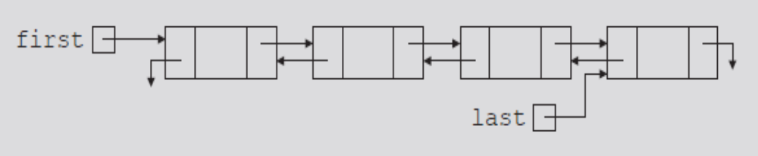
Doubly Linked Lists (cont’d.)
Linked list in which every node has a next pointer and a back pointer
  Every node contains address of next node
    Except last node
  Every node contains address of previous node
    Except the first node
FIGURE 5-27 Doubly linked list
Data Structures Using C++ 2E

Slide 61
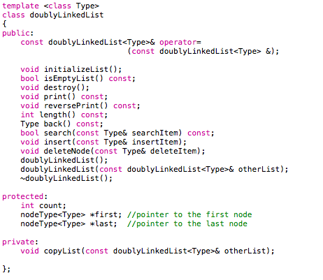
Data Structures Using C++ 2E

Slide 62
Doubly Linked Lists (cont’d.)
Default constructor
  Initializes the doubly linked list to an empty state
isEmptyList
  Returns true if the list empty
    Otherwise returns false
  List empty if pointer first is NULL
Destroy the list
  Deletes all nodes in the list
    Leaves list in an empty state
    Traverse list starting at the first node; delete each node
    count set to zero
Data Structures Using C++ 2E

Slide 63
Doubly Linked Lists (cont’d.)
Initialize the list
  Reinitializes doubly linked list to an empty state
    Can be done using the operation destroy
Length of the list
  Length of a linked list stored in variable count
Print the list
  Outputs info contained in each node
    Traverse list starting from the first node
Reverse print the list
  Outputs info contained in each node in reverse order
    Traverse list starting from the last node
Data Structures Using C++ 2E

Slide 64
Doubly Linked Lists (cont’d.)
Search the list
  Function search returns true if searchItem found
    Otherwise, it returns false
  Same as ordered linked list search algorithm
First and last elements
  Function front returns first list element
  Function back returns last list element
  If list empty, terminate the program
Data Structures Using C++ 2E

Slide 65
Doubly Linked Lists (cont’d.)
Insert a node
  Four cases
    Case 1: Insertion in an empty list
    Case 2: Insertion at the beginning of a nonempty list
    Case 3: Insertion at the end of a nonempty list
    Case 4: Insertion somewhere in a nonempty list
    Cases 1 and 2 requirement: Change value of the pointer first
    Cases 1 and 3 requirement: Change value of the pointer last
Data Structures Using C++ 2E

Slide 66
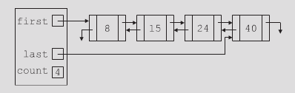
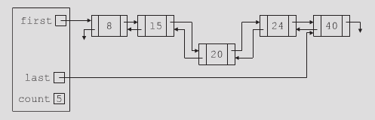
Doubly Linked Lists (cont’d.)
Insert a node (cont’d.)
  Figures 5-28 and 5-29 illustrate case 4
  See code on page 317, definition of function insert
Data Structures Using C++ 2E

Slide 67
Doubly Linked Lists (cont’d.)
Delete a node
  Four cases
    Case 1: The list is empty
    Case 2: The item to be deleted is in the first node of the list, which would require us to change the value of the pointer first
    Case 3: The item to be deleted is somewhere in the list
    Case 4: The item to be deleted is not in the list
  See code on page 319, definition of function deleteNode
Data Structures Using C++ 2E

Slide 68

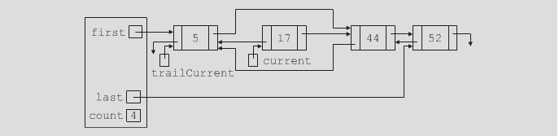

Data Structures Using C++ 2E

Slide 69
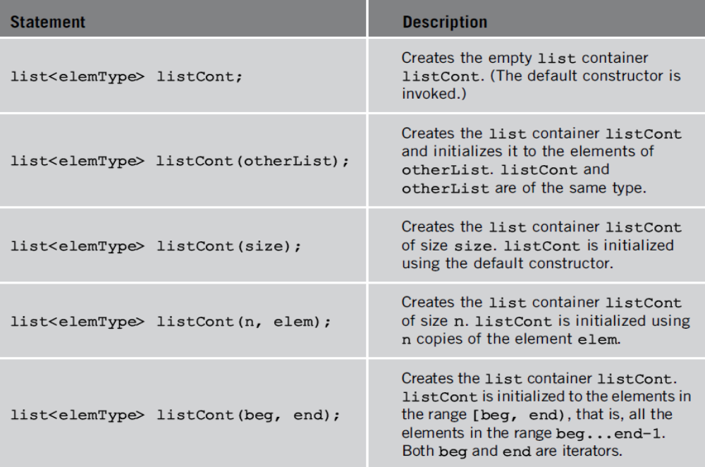
STL Sequence Container: list
class list is a Doubly linked list
#include <list>
TABLE 5-9 Various ways to declare a list object
Data Structures Using C++ 2E

Slide 70
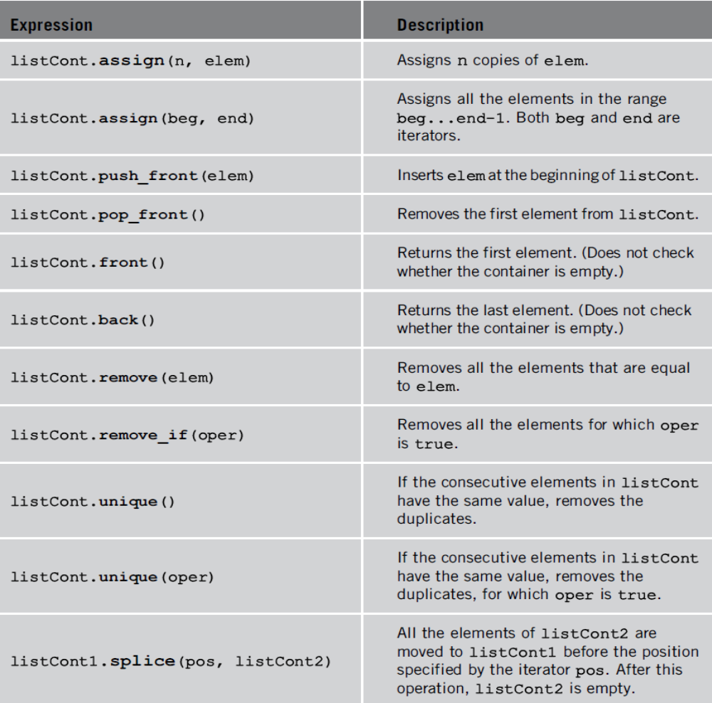
TABLE 5-10 Operations specific to a list container
Data Structures Using C++ 2E

Slide 71

TABLE 5-10 Operations specific to a list container (cont’d.)
Data Structures Using C++ 2E

Slide 72


Data Structures Using C++ 2E

Slide 73
Linked Lists with Header and Trailer Nodes
Simplify insertion and deletion
  Never insert item before the first or after the last item
  Never delete the first node
Set header node at beginning of the list
  Containing a value smaller than the smallest value in the data set
Set trailer node at end of the list
  Containing value larger than the largest value in the data set
Data Structures Using C++ 2E

Slide 74

Linked Lists with Header and Trailer Nodes (cont’d.)
Header and trailer nodes
  Serve to simplify insertion and deletion algorithms
  Not part of the actual list
Actual list located between these two nodes
Data Structures Using C++ 2E

Slide 75

Circular Linked Lists
Last node points to the first node
Basic operations
  Initialize list (to an empty state), determine if list is empty, destroy list, print list, find the list length, search for a given item, insert item, delete item, copy the list
FIGURE 5-34 Circular linked lists
Data Structures Using C++ 2E

Slide 76
Discussion
Discuss the STL container list. Describe the benefits of using this container.
Discuss ordered and unordered linked lists. What are the benefits of each? Think of applications applicable to each type of linked list and determine when to switch from an unordered list to an ordered list.
Data Structures Using C++ 2E

Slide 77
Summary
Linked list topics
  Traversal, searching, inserting, deleting
Building a linked list
  Forward, backward
Linked list as an ADT
Ordered linked lists
Doubly linked lists
STL sequence container list
Linked lists with header and trailer nodes
Circular linked lists
Data Structures Using C++ 2E

Slide 78
Resources
http://xlinux.nist.gov/dads/HTML/linkedList.html
www.codeproject.com/KB/cpp/linked_list.aspx
http://xlinux.nist.gov/dads/HTML/doublyLinkedList.html
http://msdn.microsoft.com/en-us/library/1fe2x6kt.aspx
http://xlinux.nist.gov/dads/HTML/circularlist.html
www.devx.com/getHelpOn/10MinuteSolution/16976
Data Structures Using C++ 2E

Slide 79
Self Exercises
Programming Exercises: 2, 3, 4, 5, 6, 10, 13
Data Structures Using C++ 2E

